Slide 1
Best Practices in Ending Homelessness for Single Adults
Marcella A. Maguire, Ph.D
Director, Health Systems Integration
Corporation for Supportive Housing

Slide 2
About CSH
Advancing housing solutions that:
Improve the lives of vulnerable people
Maximize public resources
Build strong, healthy communities
Notes:
CSH is a national non-profit, and our mission is to advance housing solutions that improve lives, maximize resources and strengthen communities..

Slide 3
About CSH – 4 Lines of Business
Training
&
Education
Lending
Lines of Business
Policy Reform
Consulting
&
Assistance
Notes:
CSH works across 4 lines of business:
Training and Education - CSH enriches the industry with research-backed tools, trainings and knowledge sharing.
Lending - CSH galvanizes supportive housing solutions with powerful capital funds, specialty loan products and development expertise.
Consulting and Assistance - CSH collaborates on custom community planning and cutting-edge innovations.
Policy Reform - CSH engages government leaders and public agencies through systems reform, policy collaboration and advocacy.

Slide 4

What have we learned?
Homelessness is heterogeneous.
  Rental Markets differ.
  People’s service needs differ.
  Populations change over time.
Evidenced Based Practices like Supportive Housing are too scarce.
Systems work is required.
Partnering with mainstream resources means aligning homeless systems so they can work with those systems.
Data, data, data!
Health Care needs to be easier to navigate. Particularly for people with Behavioral Health Challenges.

Slide 5
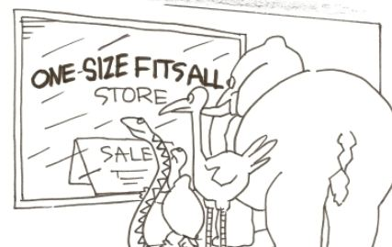
Who are you serving?
Ask this question at the system level and at the person level.
One size does not fit all. Needs Coordinated Assessment.
One community does not fit all. Rental markets vary from community to community.
What are the disabilities of persons you are serving? And what are the Evidenced Based Practices (EBP) to address those challenges.
Notes:
Are they working at all with other systems? Should they be?

Slide 6
For persons experiencing chronic Homelessness, the Evidenced Based Practice is Supportive Housing.
http://ps.psychiatryonline.org/doi/abs/10.1176/appi.ps.201300261

Slide 7
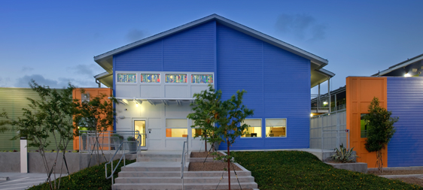
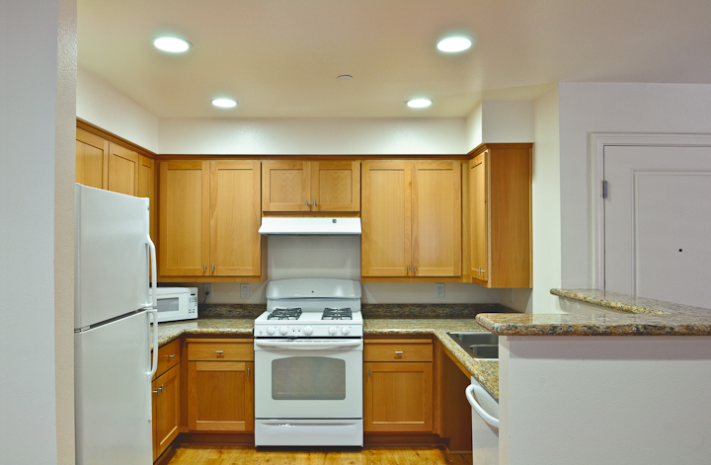
Describing Supportive Housing
Supportive housing combines affordable housing with services that help people who face the most complex challenges to live with stability, autonomy and dignity.
http://www.shanj.org/
Notes:
Nicole
Supportive housing is affordable housing where supportive services providers actively engage tenants in flexible, voluntary and comprehensive services and work with property and housing management to support tenant stability and ensure that the housing remains a positive community asset for the long-term.
Supportive housing is an innovative and proven solution to some of communities' toughest problems
Supportive housing is the scaffolding for the delivery of more effective and responsive public services.
Permanent, affordable, independent, tenant centered, flexible, voluntary
Notes from FL Housing: Either here or later you might want to mention the importance of having separate facility management and rental operations separate from services coordination and services functionsl. But that they collaborate to assist with tenant stability in the housing.

Slide 8

Essential Features of Supportive Housing
Housing
  Permanent: Not time limited, not transitional
  Deeply Affordable: To people coming out of homelessness
  Independent: Tenant holds lease with normal rights and responsibilities
Notes:
For HUD, permanent is 24 months plus one day.

Slide 9
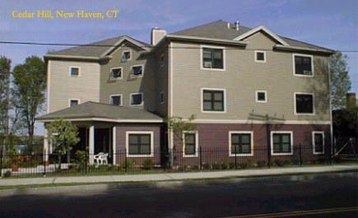
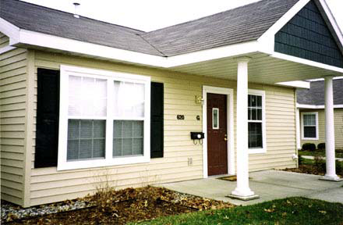
Basic Types of Supportive Housing
Single-site:
Apartment buildings exclusively or primarily housing individuals and/or families who are formerly homeless and/or have chronic health challenges.
Scattered-site:
Rent subsidized apartments leased in open market (scattered-site).
Integrated:
Apartment buildings with mixed tenancies, but with units set-aside for now formerly homeless.
Notes:
Nicole

Slide 10
Coordinated
Property/ Housing Management Staff
Supportive Services Providers
Tenants sustain stable housing
Notes:
Nicole
Trainer Talking Points:
Not a solo act!
Property and/or Housing Management staff work closely with service providers and landlords to ensure tenants sustain stable housing.

Slide 11







“Services” in Supportive Housing
Health/Mental Health Services
Child Care
Community Integration
Independent Living Skills
Employment Services and Support
Substance Use Recovery and Support
Budgeting and Financial Management Support
Services can be Community Based or Provided Directly by your Agency
Notes:
Match services to level of disability and engagement in recovery
Here are some examples of services that make the difference in a person being housed versus homeless:
Health and mental health services and counseling
Child care
Community Integration
Independent living skills
Employment services and support
Substance use recovery and support
Budgeting and financial management support
Services such as these, in combination with a decent place to live, provide the support system people need to break out of the cycle of long-term homelessness.
Case managers are the key here. Services can be provided by the client directly, OR can be community based, meaning those supportive, behavioral health and healthcare services in the community that are available to residents of a Development that are not provided by the Development, and usually not at the Development. They include transportation, case management, counseling, education and skills training, physical and dental care, and benefits assistance.

Slide 12


Systems Work
Ending Homelessness means a continuum of programs that address the differing needs in your community.
Ending Homelessness means a variety of planning activities that bring the community together around this issue.
Ending Homelessness means having a system that adapts as needs change.
Ending Homelessness means partnerships with a broad base of stakeholders.
Ending Homelessness means documenting gaps in your communities and strategizing new and bold ideas to address those gaps.

Slide 13

DATA, DATA, DATA!
Ending Homelessness means collecting data to better understand whose homeless in your community, what the best practice is to address that issue and how do we help people meet the challenges in their community
Ending Homelessness means analyzing and reporting on that data regularly to engage stakeholders, track progress and tell the story about impact.
Ending Homelessness means putting resources into information technology and systems.
Ending Homelessness means being committed to data quality so that the information you act on is as good as it can be.

Slide 14

Aligning Homeless Systems with Health Care Systems
Health Systems have a language all their own.
Health Systems have priorities, learn them and how to address them.
Health Systems have resources, learn what they are, how to speak to them and how they can be used to help end homelessness.
Health Systems are BIG and complicated and not easy to work with at times. You will need allies and keep pushing.
Notes:
$530 billion in Federal FY 2015

Slide 15
Social Determinants of Health
Health
Housing
Economic Status
Poverty
Race
Employ-ment
“…circumstances in which people are born, grow up, live, work and age, and the systems put in place to deal with illness. These circumstances are in turn shaped by a wider set of forces: economics, social policies, and politics.“
- World Health Organization
Notes:
As a health professional, you are probably familiar with the social determinants of health, which are the economic and social conditions that affect health outcomes and are the underlying and contributing factors of health inequities. Examples of these determinants include educational attainment, employment, the surrounding environment and housing – both housing conditions and the lack of housing itself.
For homeless and chronically ill populations - the lack of housing dictates health outcomes. Merely having a stable residence not only provides privacy and safety but also a place to rest and recuperate as well as store needed medications.
Let’s consider a scenario…

Slide 16

Current Focus on Integrated Care
Analysis of health care systems shows a variety of persons with high health care costs.
Persons with Behavioral Health Challenges are one of these populations and there are models and strategies that can impact.
People Need Integrated Physical Health and Behavioral Health care. Bringing BH support to Primary Care. Health Homes that serve persons with BH challenges.
http://www.integration.samhsa.gov/integrated-care-models

Slide 17

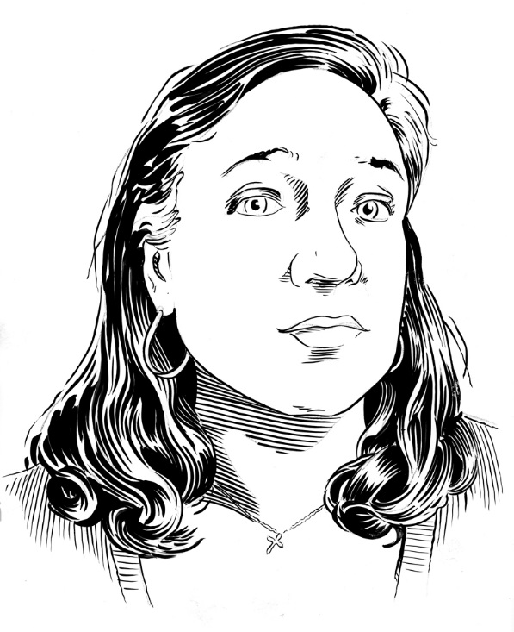
Marcella Maguire, Ph.D.
Director, Health Systems Integration
Corporation for Supportive Housing
Marcella.Maguire@csh.org
Twitter- @cella65

